Slide 1
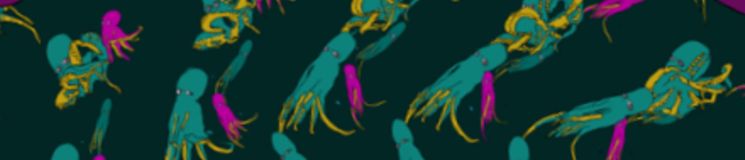
Ultra-Hi Definition Real Time Zoetrope
Nomso Ashiogwu, Daniel Cleaver, Mick Harrigan, Christian Lostoski
Notes:
All

Slide 2
Mission and Requirements Analysis
Interactive art installation
Rotate image at correct speed
Deliverables
UHDRTZ System
User/Setup Guide
Maintenance Interface
Notes:
To achieve this effect, a live video feed of the artwork is rotated digitally, controlled by a hand crank.
Nomso
The Ultra Hi-Definition Real Time Zoetrope (UHDRTZ) is an interactive art installation based around a disc-shaped artwork that appears to animate when rotated at the correct speed.

Slide 3
Operational Concept
How does it work?
Stationary artwork
Spin the crank and the image will spin accordingly
Interfaces
Human to Crank
Crank to Arduino
Arduino to FPGA
Camera to FPGA
FPGA to Projector
Notes:
Chrisitan

Slide 4
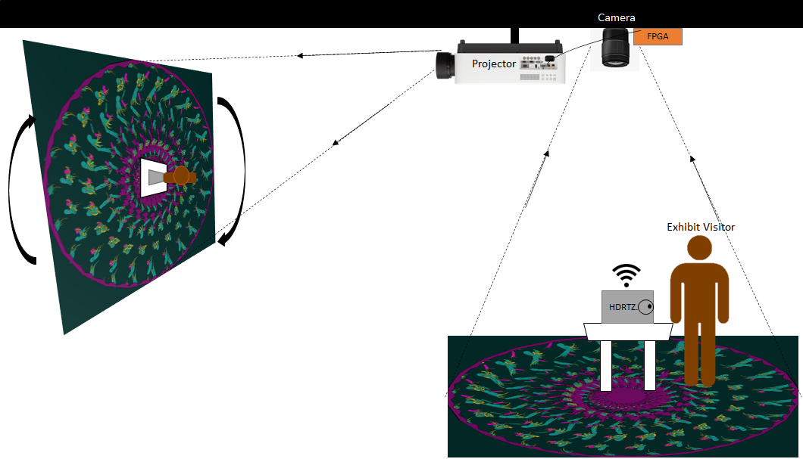
Mission Scenario Diagram
Notes:
Christian

Slide 5
Preliminary Requirements Allocation
Crank usability
Accurate rotational output
Physical crank haptics
Process Video
Zoom and crop
Generate Video Output
4K [3840x2160]
24 FPS
Audio requirements
Play song
Direction and speed
Notes:
Dan

Slide 6
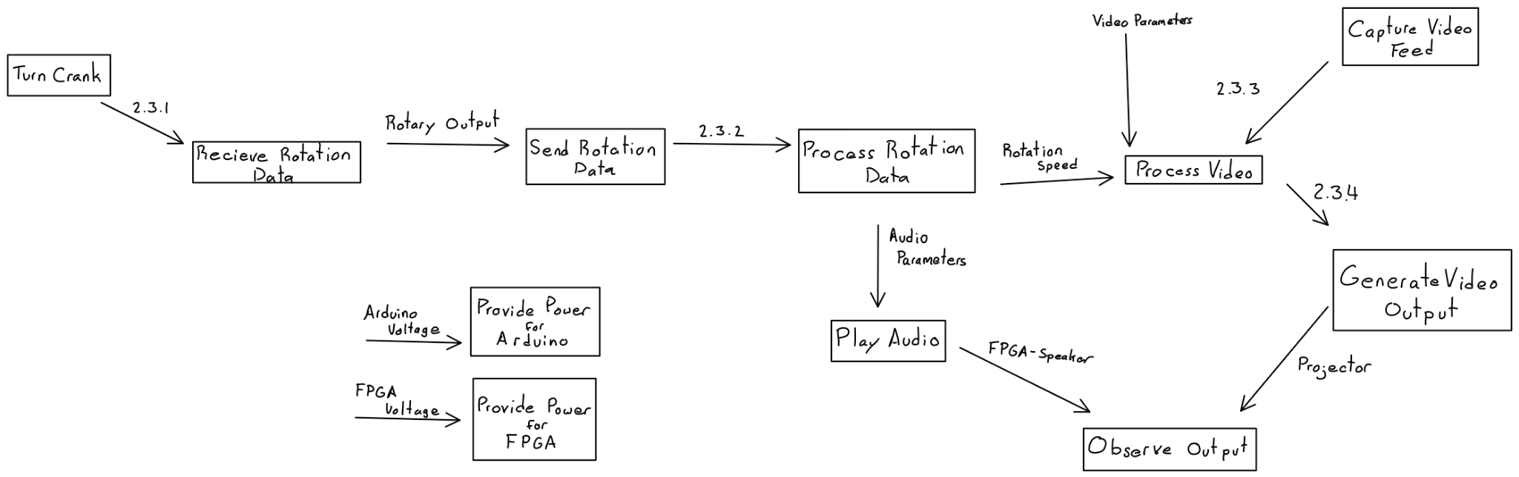
Functional Flow Analysis
Notes:
Mick

Slide 7

Milestone Schedules
Demo of the final project - Dec 2023/Mar 2023
4K output - Dec 2022
SSH Capabilities - Dec 2022
User Interface - Jan 2023/ Feb 2023
Run on Boot - Feb 2023
Notes:
Nomso - to be animated

Slide 8
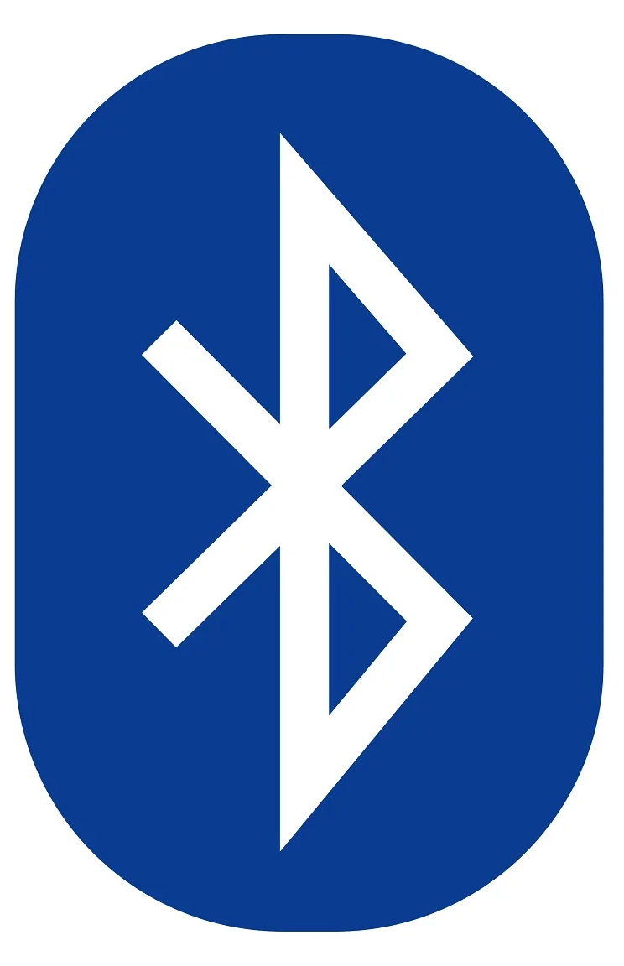
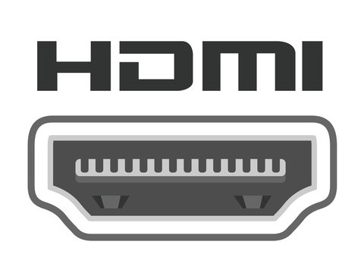
Constraints
Bluetooth
USB 3.0
HDMI
4K 3840 x 2160
Arduino must fit in crank housing
Notes:
Christian - to be animated

Slide 9
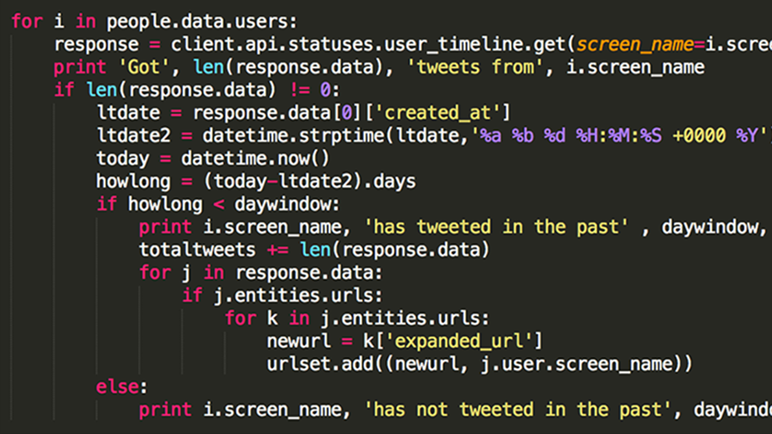
Project Risk Analysis
Reliability and Resilience
Long term usage requires maintenance
Preventative measures
Better code
Safer and smaller code
Corrective measures
SSH access
Dedicated IP addressing
Notes:
Mick - TBA

Slide 10
Technical Performance Measurement Planning
How will you measure compliance with your requirements?
Analyze code
Use test subjects
4K monitor
What testing will you do by 12/15/2022?
Remote troubleshooting
Run on boot
4K output
Notes:
Dan

Slide 11
Questions?
Thank you for your time

